Slide 1
Market Prediction of Used Car on eBAY
0656033 許金賢 資科工所
0656620 盧俊言 多工所
0656622 林子皓 多工所

Slide 2
RRRRRRRRRRRRRRRRRRRRRRRRRRRRR
為什麼選這個資料作圖講原因
問題定義是否清楚 20%
相關文獻是否完備 10%(換幾篇top conference)
方法合理性與深度 25%
實驗完整度 25%
(資料preprocessing、工具使用說明、為什麼用這個工具、如何參數最佳化、結果討論)
Presentation 20%
(包含slide、台風）

Slide 3
OUTLINE
Introduction
Problem Definition
Data Observation
Model Prediction
Data preprocessing

Slide 4
INTRODUCTION

Slide 5
PROBLEM DEFINITION
Data Observation
Try different clustering methods and observe the visualization outputs to find some trend & relation between a specific attribute and price.
2. Model Prediction
Find f() that minimize E((price_true - f(attr))^2) for each column.
For real-valued fields: find first-order approximation (y=ax+b).
i.e. Find the Correlation coefficient and mean between price and specific attributes (real-valued fields).
For discrete-valued fields: we only use mean.
Notes:
use metrics to evaluate between models
greedy search

Slide 6
DATA PREPROCESSING

Slide 7


Data Observation
Notes:
data observation combine to one page

Slide 8

Data Observation
1) brand vs. price

Slide 9
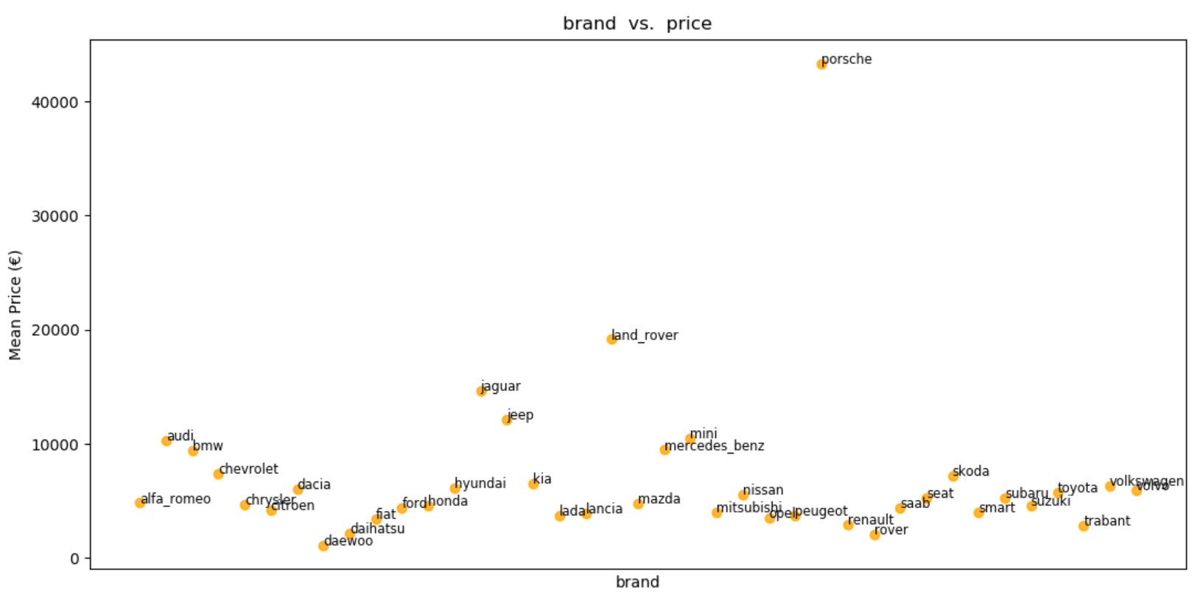

Slide 10
Data Observation
39 brands in 247367 data
Porsche has much higher price than other brands.
Most of used cars are lower than 10000
→ the others are famous for Sports car and Sport Utility Vehicle.
Notes:
data observation combine to one page

Slide 12

Data Observation
2) model in the same brand vs. price

Slide 13
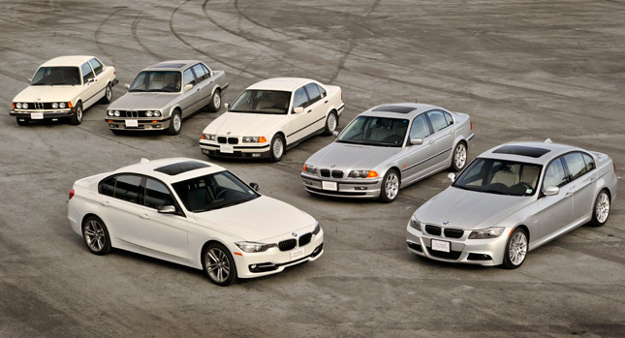
Data Observation
- 250 models in 36 brands
- We choose the brand which has larger than 10 models.
volkswagen 22
ford 14
mercedes_benz 18
audi 16
opel 16

Slide 14
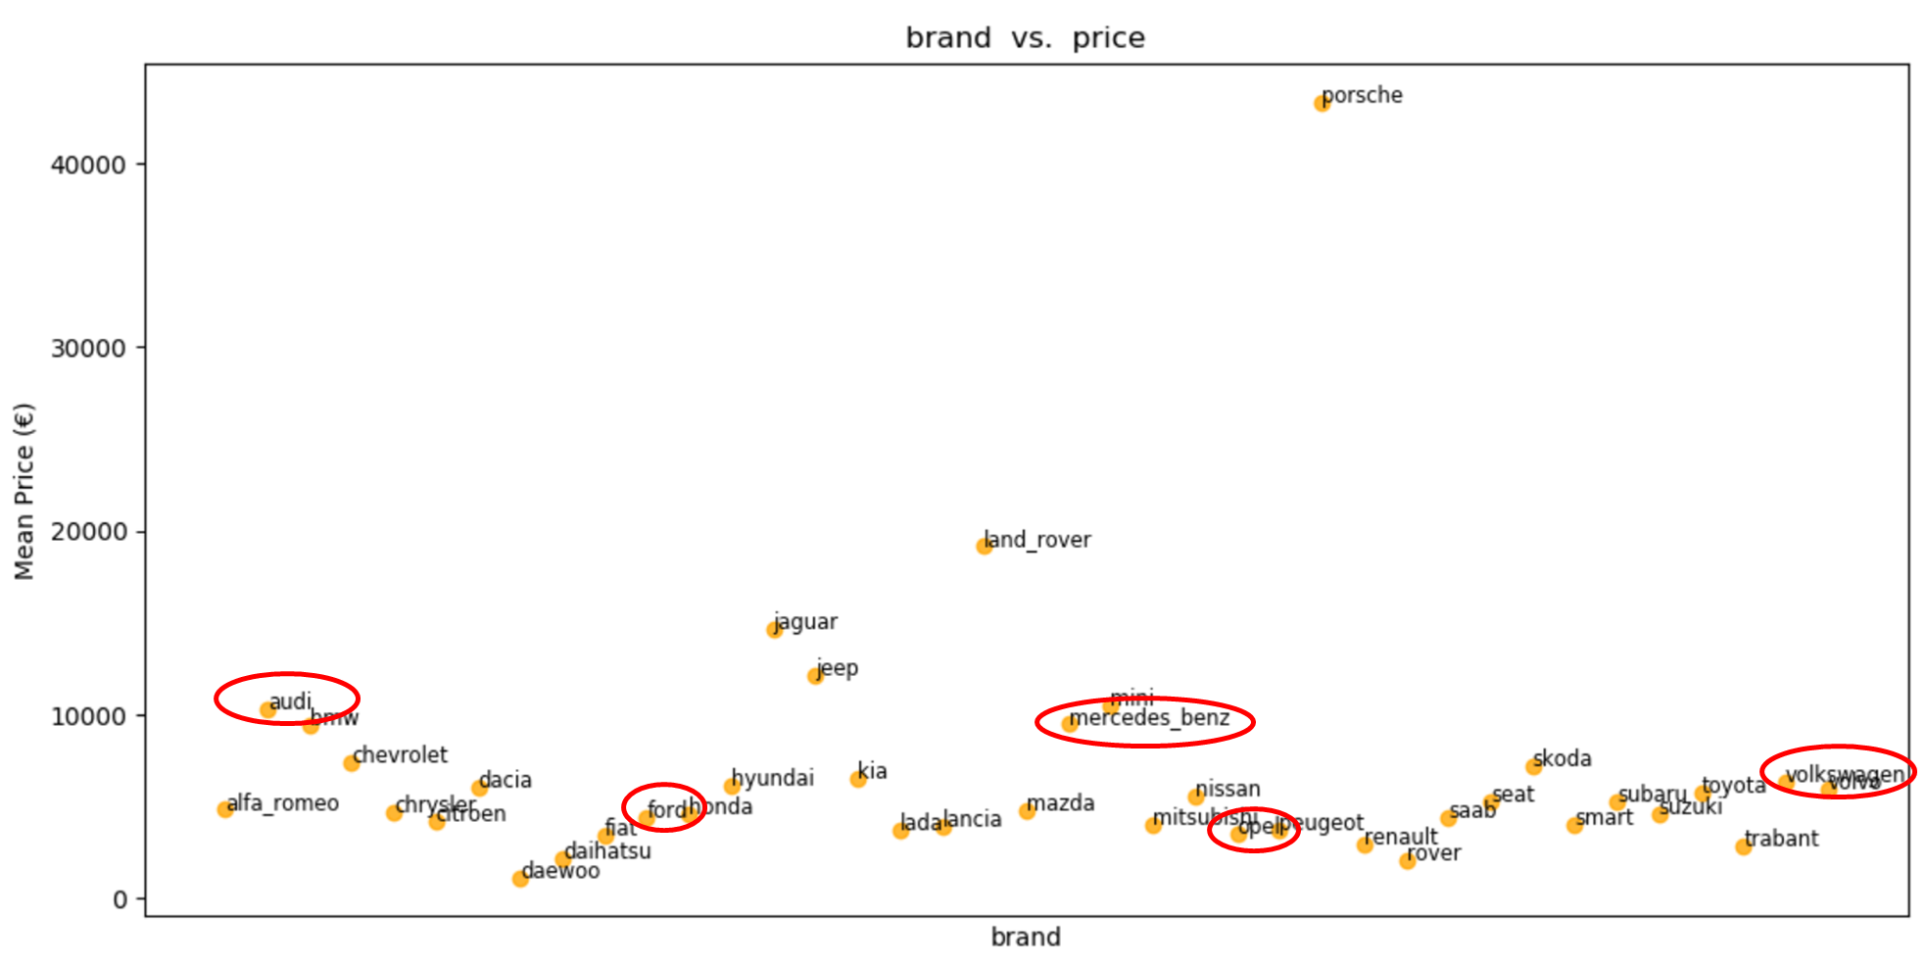

Slide 15
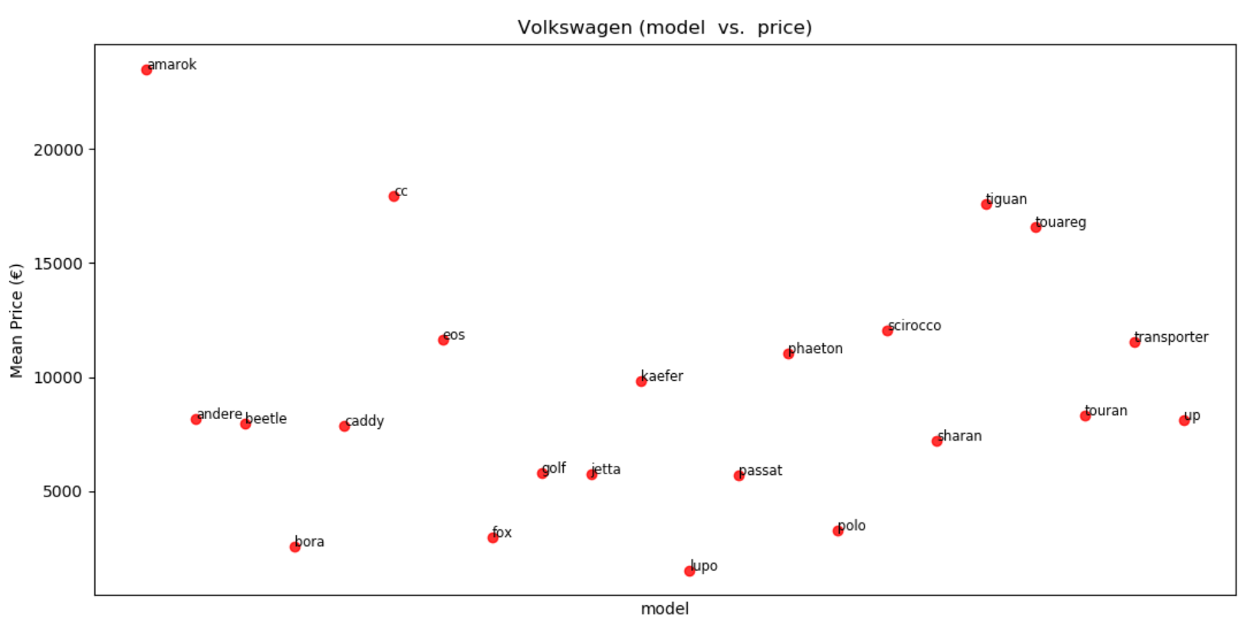


Slide 16
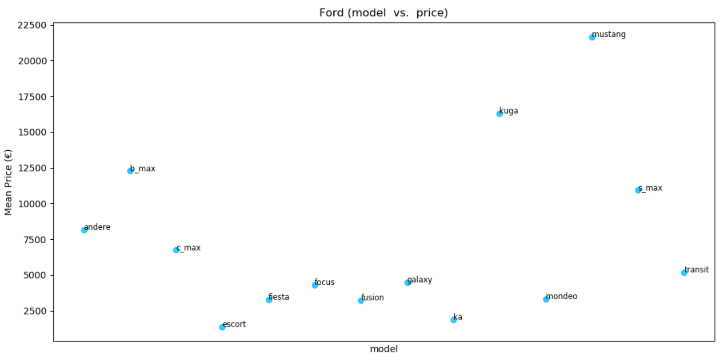


Slide 17
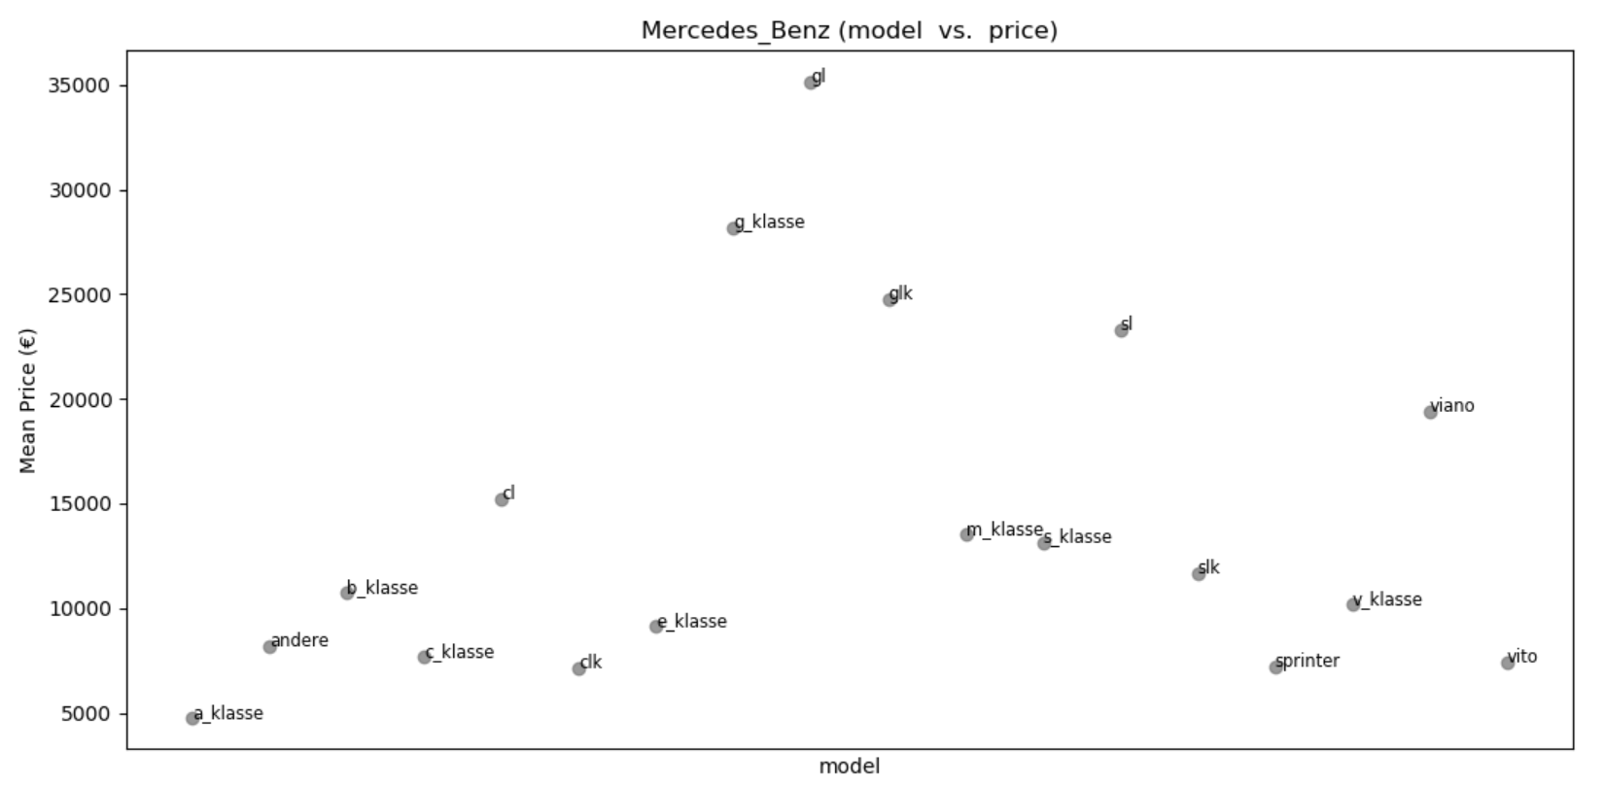


Slide 18
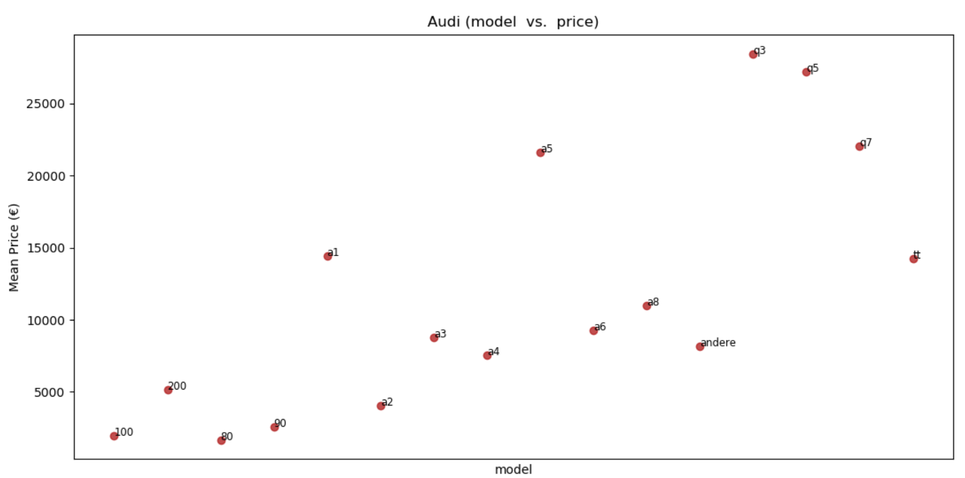


Slide 19

Data Observation
powerPS vs. Price

Slide 20
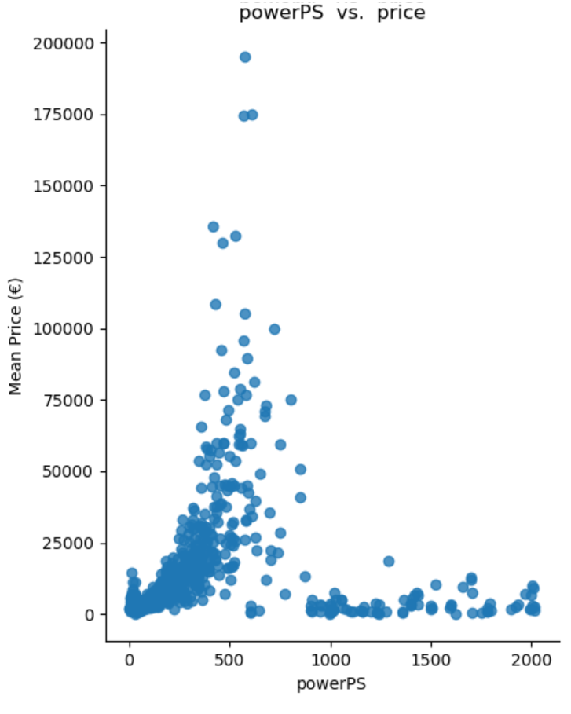
Data Observation
Using all data
We can obvious see the price increment
following by PowerPS.

Slide 21
Data Observation
Using all data
We can obvious see the price increment
following by PowerPS.
Because there are different brands and models,
some irregular plots would be produce.

Slide 22
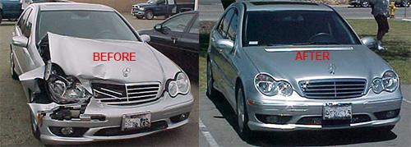
Data Observation
notRepairedDamage vs. Price

Slide 23


Data Observation
We take
Porsche : which has the highest mean price
Daewoo : which has the lowest mean price
… to do comparison in NotRepairedDamage attribute.
Notes:
原因: 越貴重 價值越高 挑極端比較

Slide 25
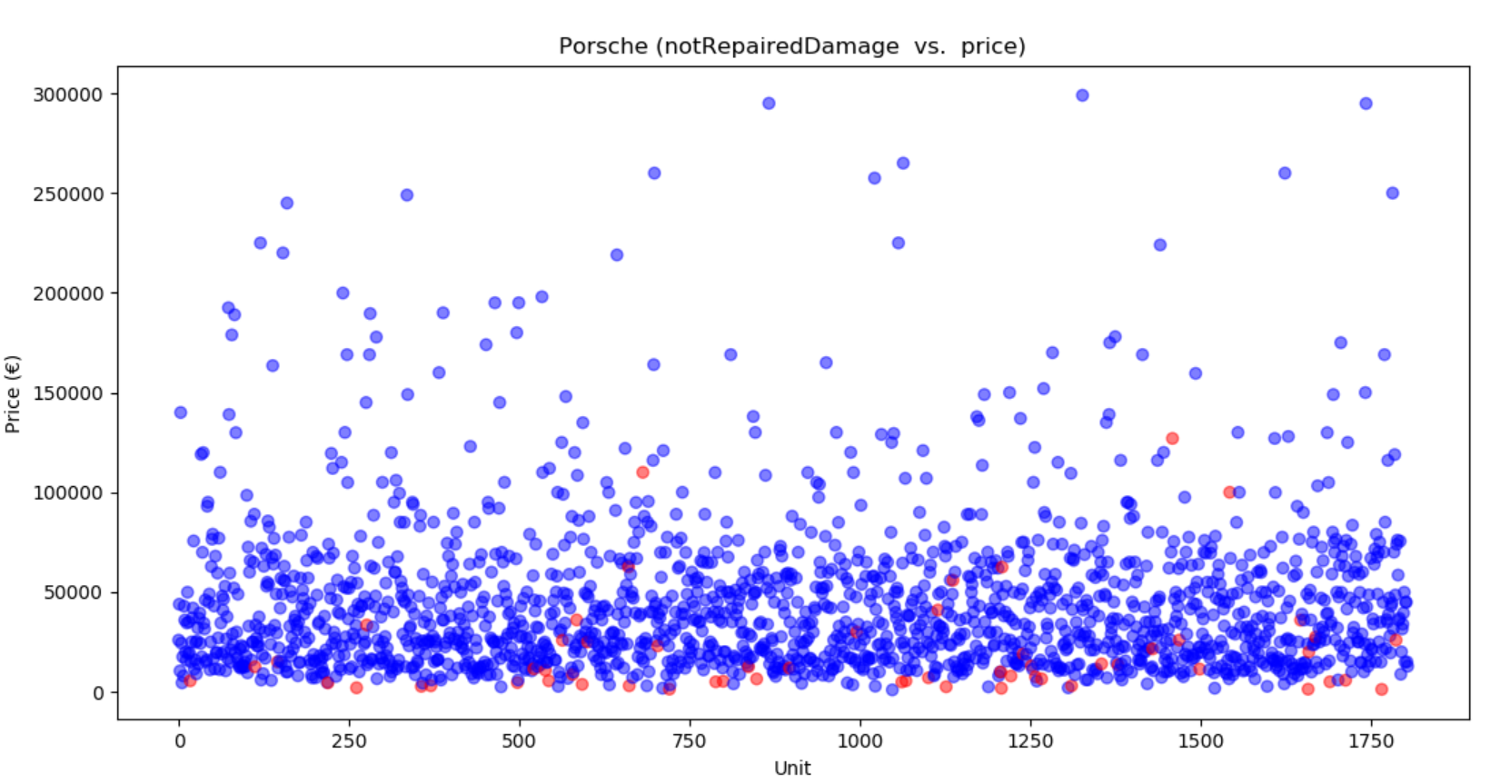


Slide 26
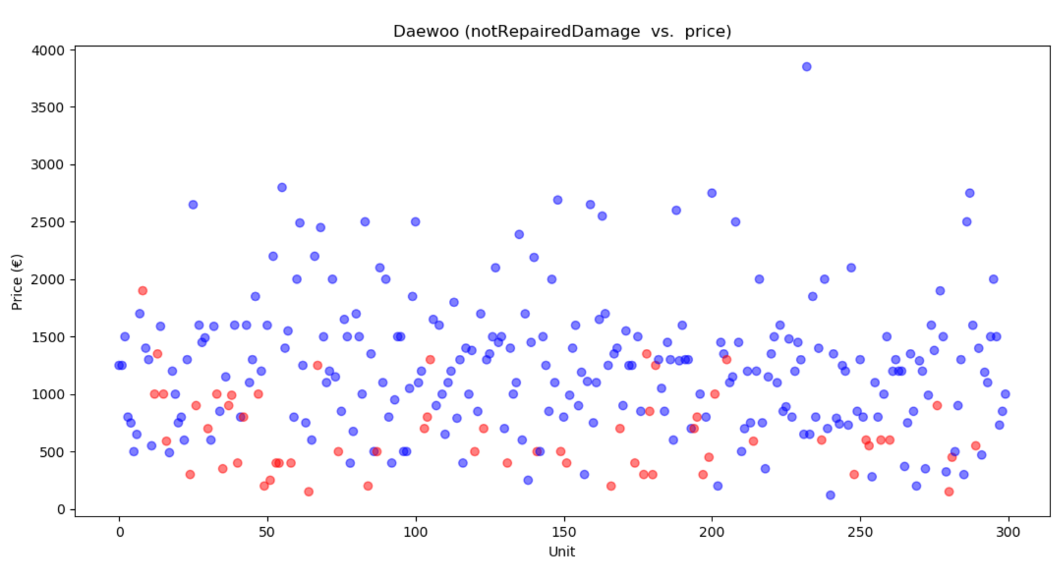

Slide 27
Data Observation
- We can see that blue points are more than red points.
→ It means used cars are usually repaired damage by the seller.
- Looking at the scatter plot, we can know that
… cars which are repaired have higher price than those are not.
Consumers also can evaluate whether repairing themselves can cost less money than buying a already repaired car.
Again, some repaired cars may seem like having the same price as not repaired cars because of different models.
Notes:
原因: 越貴重 價值越高 挑極端比較

Slide 28
Mining Tasks - Model Prediction
Predicting price from some features in the data set, also may emphasize the weight of several obvious attributes (especially brand, model, powerPS and notRepairedDamage, which may influence the customers’ willingness to buy the car) to compare the importance of these attributes.

Slide 29
Existing Works
Pudaruth (2014) [1]
Use different techniques like multiple linear regression analysis, K-nearest neighbors, Naïve Bayes and decision trees to investigate the application of supervised machine learning techniques to predict the price of used cars.
Main limitation: low number of records have been used.
Notes:
Pudaruth [1] used different techniques like multiple linear regression analysis, K-nearest neighbors, Naïve Bayes and decision trees to investigate the application of supervised machine learning techniques to predict the price of used cars. The main limitation of this study is the low number of records that have been used.

Slide 30
Existing Works
Chuancan, Lulu, and Cong (2017) [2]
Results:
Random forest has a stable but not ideal effect in price evaluation model for a certain car make
It shows great advantage in the universal model compared with linear regression.
Random forest is an optimal algorithm when handling complex models with a large number of variables and samples
Random forest shows no obvious advantage when coping with simple models with less variables.
Notes:
Chuancan, Lulu, and Cong [2] collect more than 100,000 used car dealing records throughout China to do empirical analysis on a thorough comparison of two algorithms: linear regression and random forest. These two algorithms are used to predict used car price in three different models: model for a certain car make, model for a certain car series and universal model. Results show that random forest has a stable but not ideal effect in price evaluation model for a certain car make, but it shows great advantage in the universal model compared with linear regression. This indicates that random forest is an optimal algorithm when handling complex models with a large number of variables and samples, yet it shows no obvious advantage when coping with simple models with less variables.

Slide 31
Dataset description
The fields required in our project are below:
seller - Private / Dealer
price - The price on the ad to sell the car
vehicleType - SUV, Coupe…
yearOfRegistration - At which year the car was first registered
gearbox - Auto / Manual
powerPS - Vehicle power in PS (no need to convert to Hourse Power because 1HP＝1.015PS)
model - Similar to name, but without brand and engine displacement
monthOfRegistration - At which month the car was first registered
fuelType - Diesel / Benzin(gasoline)
brand - Volkswagen, Audi, BMW…
notRepairedDamage - If the car has a damage which is not repaired yet

Slide 32
Expected Solutions/Methods
Clustering: K-means, DBSCAN
Model Prediction:
SVM
SVM is better able to deal with very high dimensional data (number of features used to predict the price) and can avoid both overfitting and underfitting.
Linear regression v.s Random forest
We try to do a comparison between linear regression models and random forest models.
By theoretical analysis, we think that random forest may help us to establish a model with high accuracy.
Notes:
跑不同model 調參數，最後在做比較

Slide 33
Library/Packages used in our project
Read: pandas
Models: scikit-learn
Draw: matplotlib

Slide 34


Challenges/Issues/Difficulties
Region limitation: is only used in Germany. [3]
Time limitation: Data collected are only from Mar. - Apr. 2016. [3]
The column “kilometer” (How many kilometers the car has driven) has the maximum of 150000 km, which means the vehicles being driven more than 150000 km can not be discovered, and result in too many rows with the value of 150000. So we decide to eliminate this column.
Some columns are not well-ordering, e.g. brand. There’re 40 brands in the dataset. We have to put more 40 dimensions for each brand (and value of each is 0 or 1). The number of dimension is too high.
Some records seem to be mistakes. It needs a good method to drop them as less manpower as possible, or we’ll spend much time on deciding which are incorrect.

Slide 35
Plan before 2017/1/13
items | Date | Preprocessing | Clustering | Linear Regression & SVM | Random Forest | Comparison & Observation | Report
2017 | 12/18 - 12/24
 | 12/25 - 12/31
2018 | 1/1 - 1/7
 | 1/8 - 1/13
Year

Slide 36
Reference
[1] Pudaruth,S. 2014. “Predicting the Price of Used Cars Using Machine Learning Techniques”, International Journal of information & Computation Technology,4(7)
[2] C Chen, L Hao, C Xu., Comparative analysis of used car price evaluation models - AIP Conference Proceedings, 2017
[3] Used cars database - Over 370,000 used cars scraped from Ebay Kleinanzeigen. Availble from: https://www.kaggle.com/orgesleka/used-cars-database

